Slide 1

ITLec
Information technology
lectures
http://www.MSDynamicsArab.com
By ITLec.com
https://www.meetup.com/Riyadh-Customer-Relationship-Management-Meetup/

Slide 2

About Me
Rasheed Gomaa
Tech. Lead/ Techno-Functional Consultant
Multi-Culture experience (Australia ,USA, Dubai, Saudi, ..).
+35 Successful Project
Nuget (+370K) https://www.nuget.org/profiles/ITLec
Github (+15 Repositories) https://github.com/ITLec
https://twitter.com/Rasheed_ITLec
Rasheed@ITLec.com

Slide 3

Dynamics 365 – Riyadh User Group
Moving to Unified Interface
Author : Rasheed@ITLec.com

Slide 4
Agenda
MS CRM UI History
What is powerApp?
Unified Interface Overview
Why Unified Interface
Capabilities not yet on Unified Interface
Unified Interface Vs. Legacy web client
When/How Long
Important changes (deprecations)
Join US

Slide 5
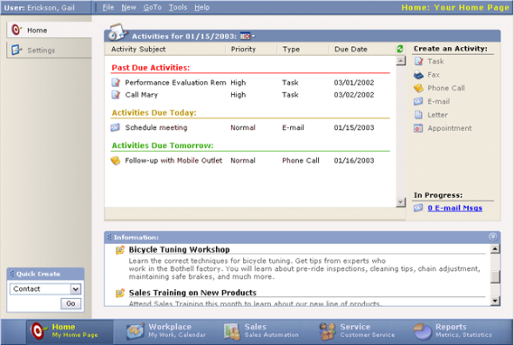
Microsoft CRM 1.2 was released on December 8, 2003
Notes:
Crystal Report

Slide 6
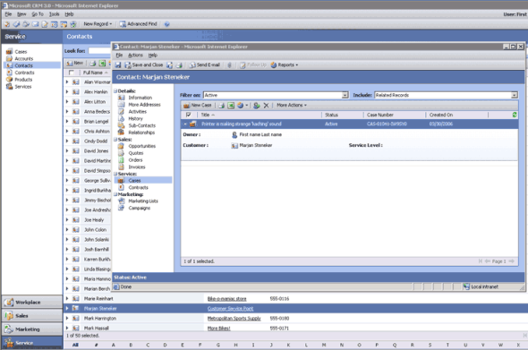
Microsoft CRM 3.0 was released on December 5, 2005
Notes:
SSRS

Slide 7
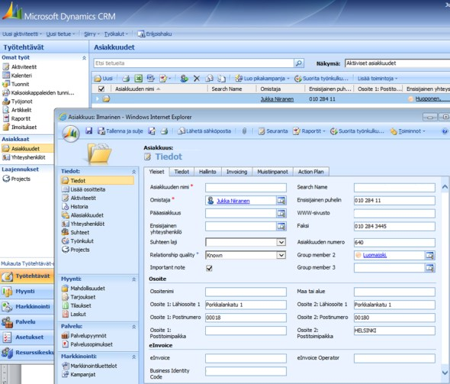
Microsoft CRM 4.0 was released on December , 2007
Notes:
“multi-everything”: multiple languages, multiple currencies and, most importantly, multiple tenants.
Windows Workflow Foundation

Slide 8
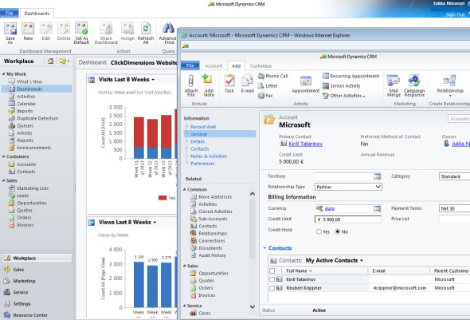
Dynamics CRM 2011
Notes:
CRM 2011 introduced the concept of solutions and solution layers
The ribbon from Office 2007 was now added into CRM
headers & footers and a wealth of web resource types

Slide 9
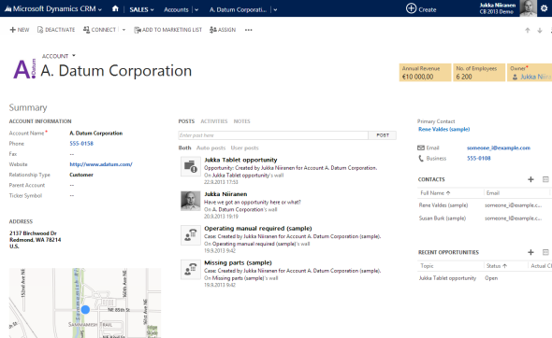
Dynamics CRM 2013
Notes:
Outlook
tablet devices powered by Windows 8 and iOS, smartphones running Windows Phone 8, Android or iOS

Slide 10
What is PowerApp?
a suite of apps, services, connectors and data platform that provides a rapid application development environment to build custom apps for your business needs.
Canvas & Data Model
Dynamics 365 = PowerApp & Common Data Service
Reference: https://docs.microsoft.com/en-us/powerapps/powerapps-overview

Slide 11
What is Microsoft Power Platform?
One high productivity platform that spans Office 365, Dynamics 365, and standalone applications
Dynamics 365
Office 365
Mobile Apps
Web Apps
PowerApps
Flow
Power BI
Common Data Service
Data connectors

Slide 12
Unified Interface for model-driven apps in PowerApps
The Unified Interface uses responsive web design principles to provide an optimal viewing and interaction experience for any screen size, device, or orientation. It brings all the rich experiences to any client that you are using. Whether you are on a browser, tablet, or phone, you will be able to consume similar experiences.
Reference: https://docs.microsoft.com/en-us/power-platform/admin/about-unified-interface

Slide 13




Dynamics 365 Customer Engagement UI History
Dynamics 365 Customer Engagement earlier versions
Legacy web client
Mobile Web
Mobile App
Outlook
Desktop Web Browsers
Mobile Web Browsers
Mobile Apps (Tablet & Phone)
Outlook Client
Dynamics 365 Customer Engagement today’s version - all of our customers are on this now
Legacy web client
Unified Interface
Desktop Web Browsers
Modern Responsive Web Experience (Desktop Web Browsers & Mobile Web Browsers)
Mobile Apps (Tablet & Phone)
App for Outlook

Slide 14

Reasons for Microsoft investment in Unified Interface & future direction
Why did Microsoft invest “all-in” on Unified Interface?
Important
To modernize fundamental application technology and UX design
To handle broader range of accessibility standards
To reduce complexity, cost and time delays caused by
Duplicated investments across core framework, coding languages, supported browsers of various application clients.
Forked code base also resulted in feature differences, regressions and timing of fixes and new features, which also impacted you work!
Unified Interface will also reduce your implementation & support costs!
Legacy web client support for existing customers will co-exist to allow a period of time for your transition but should not be relied on as the reason to further delay migration to Unified Interface.
Unified Interface is the strategic direction for all the primary apps & has been the only client to receive new product features and future roadmap investments.
This is your call to action to being your migration journey!
Dynamics 365 Customer Engagement future state
Legacy web client
Unified Interface
Desktop Web Browsers
Modern Responsive Web Experience (Desktop Web Browsers & Mobile Web Browsers)
Mobile Apps (Tablet & Phone)
App for Outlook

Slide 15
Why should you move to Unified Interface?

Slide 16




Why you should care to move to Unified Interface:
Optimize Investment
Introduce Exciting UI
Enhance Productivity
Improve Performance
Microsoft has already enabled all native first party applications on the Unified Interface for Dynamics 365 Customer Engagement (Sales, Customer Service, Marketing, Field Service, etc)
Important: There is no investment in new features or improvements to the legacy web client.

Slide 17
Unified Interface introduces many new features over the legacy web client
New App UI
New Navigation Menu
New Apps Concept
Full Responsive Design
Improved Data Exploration
Record Set Navigation
Interactive Dashboards
Improved Lookup
Improved Form Experiences
Dynamic Form Reflow
New Reference Panel
Use or Build Custom Controls

Slide 18




Unified Interface is the only place to benefit from opportunity to
Onboard easily to Mobile and Outlook
Use New Controls Fields & Views
Use PowerApps Component Framework
Embed PowerApp Canvas Experiences
Add Contextual PowerBI to Forms
Gain Performance in UI & Task Efficiency

Slide 19
Unified Interface performance improvements
In our testing of a sample application - here are average performance results we noted:
63%
Improvement in grid load
37%
Improvement in form load
45%
Improvement in dashboard load
30%
Improvement in quick create load
27%
Improvement in mobile app launch

Slide 20
Capabilities not yet on Unified Interface
Custom styling of advanced chart properties (excluding colors and basic formatting)
Composite address control
Global notifications
Admin experiences
Editable grids on phones
Learning Path
Reference: https://docs.microsoft.com/en-us/power-platform/admin/about-unified-interface

Slide 21
See & compare!
What happens to my existing app?
Unified Interface vs Legacy web client

Slide 22
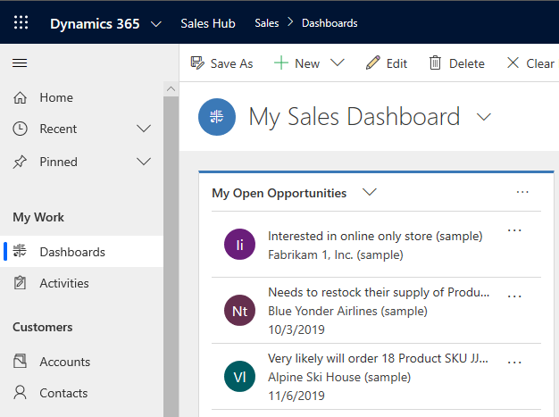
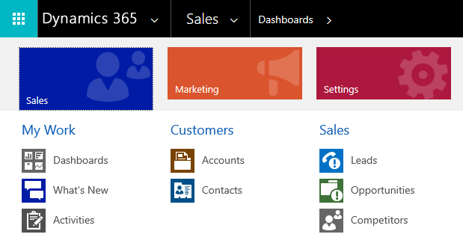
New Navigation Bar & New Navigation Menu
Unified Interface
Legacy web client

Slide 23
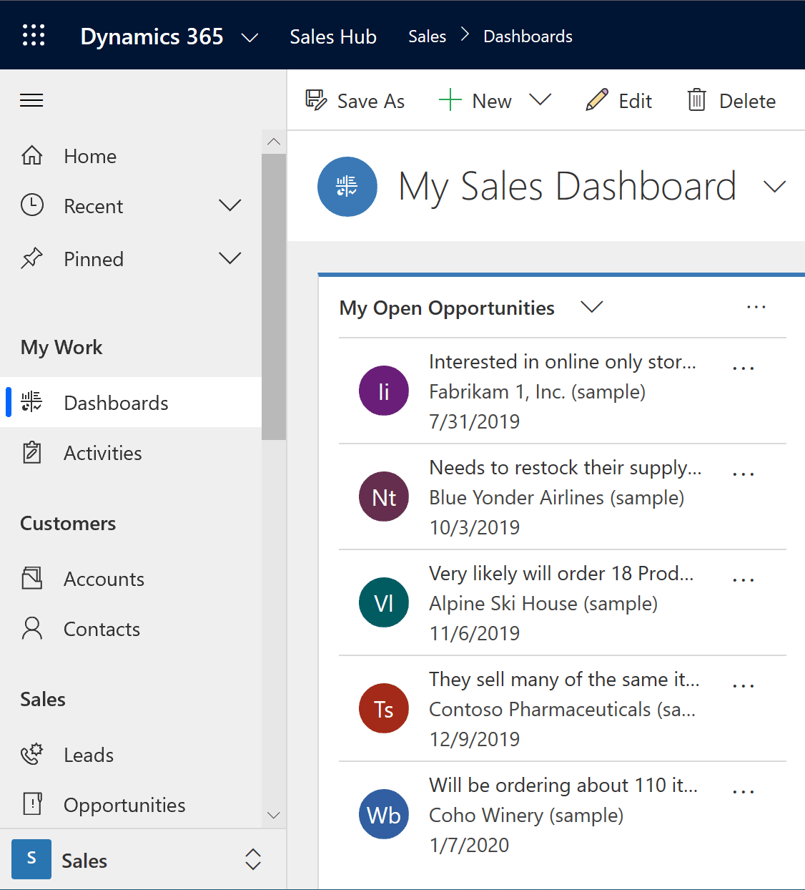
New Navigation Menu
Unified Interface
Legacy web client
Menu is always present
Navigation possible even when Menu is minimized

Slide 24
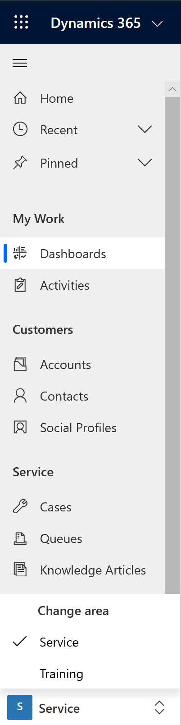
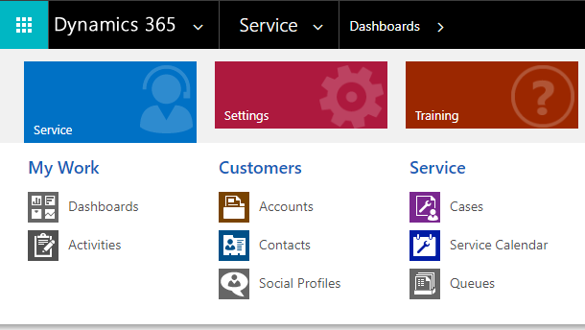
Improved Navigation Menu retains existing fundamental structure
Unified Interface
Legacy web client
3
1
1
2
2
All sitemap structural components are still part of the new menu
Groups
Items
Areas
3

Slide 25
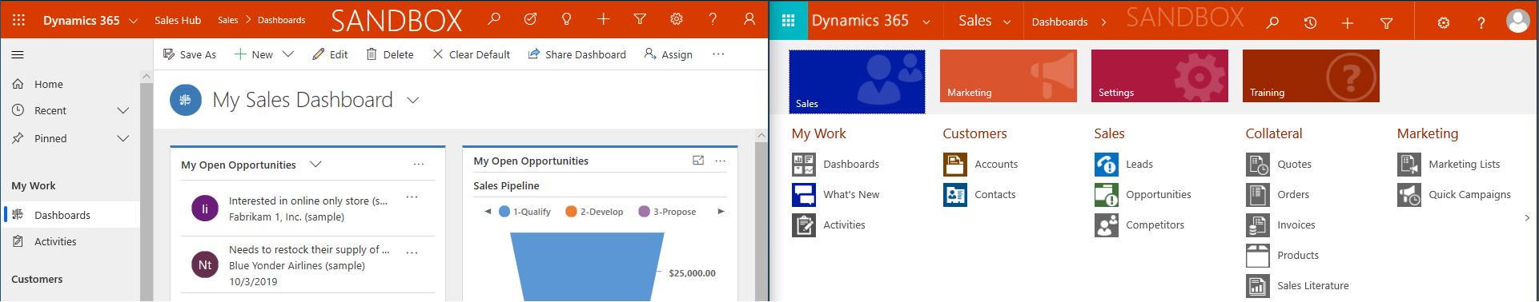
New Navigation Bar – improves support for your brand color and logo
Legacy web client
Unified Interface
Continue to use your logo and your brand color as set in your environment theme,
now the color is carried across the whole top navigation bar
Here is example of other themes show this enhancement:
Unified Interface
Legacy web client

Slide 26
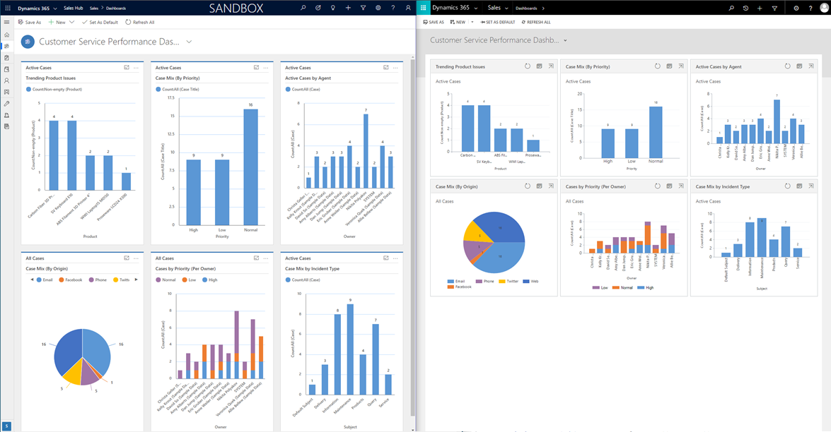
Dashboards – System or Personal continue as designed with improvements
Unified Interface
Legacy web client
1
Improved Charts
Using full screen
2

Slide 27
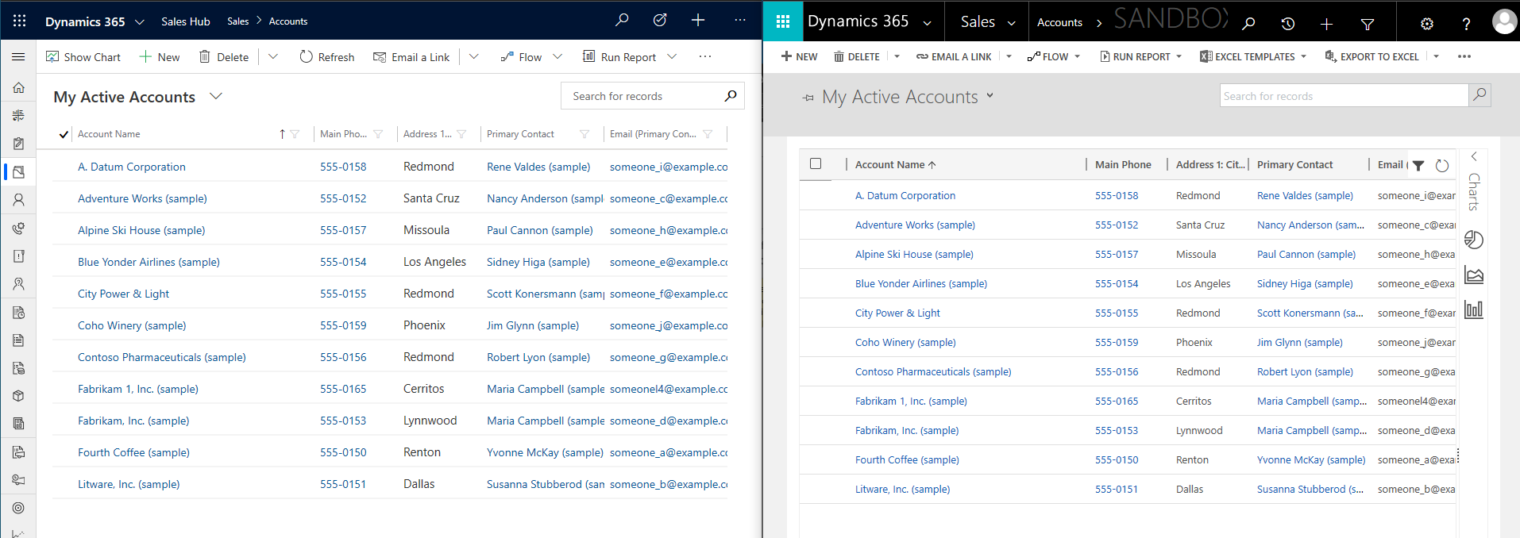
Views – System Views and Personal Views continue as designed
Unified Interface
Legacy web client
1
2
Improved View Header Density
Improved View Row Density

Slide 28
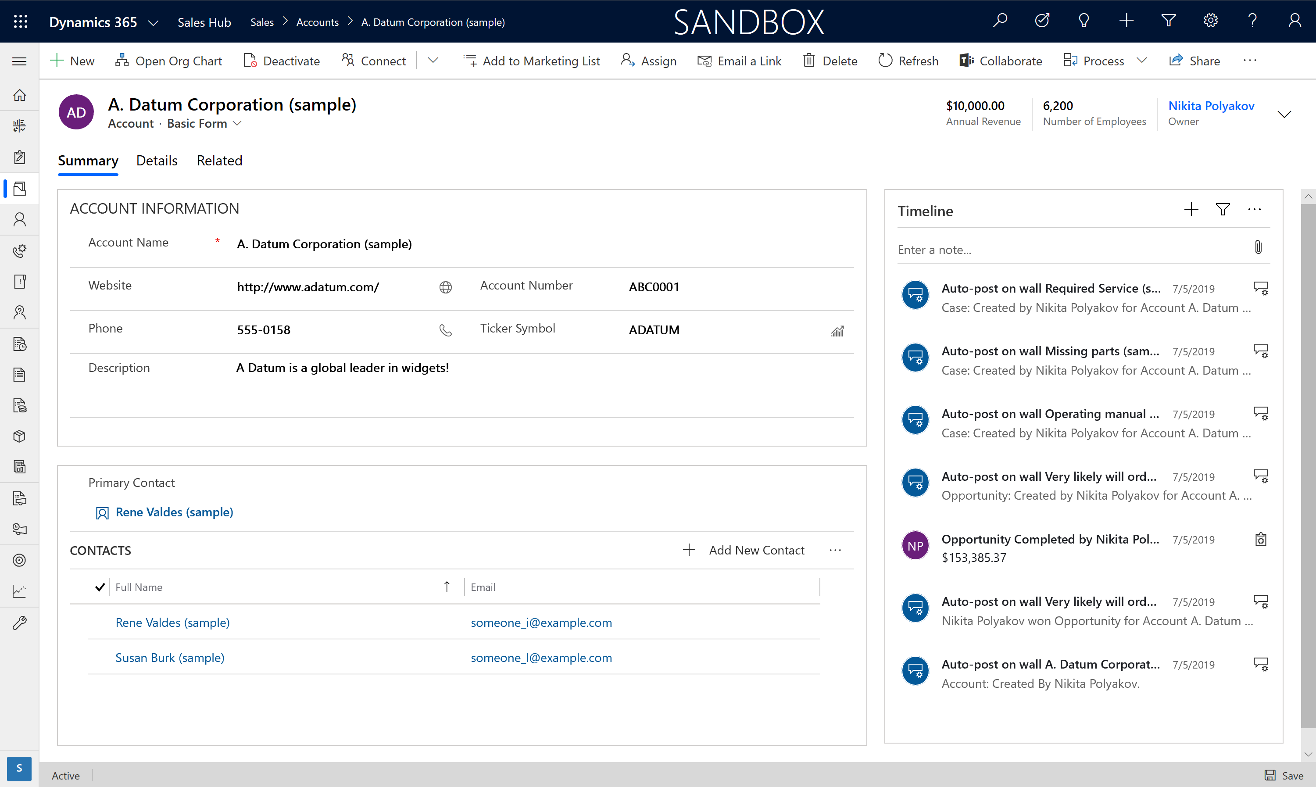
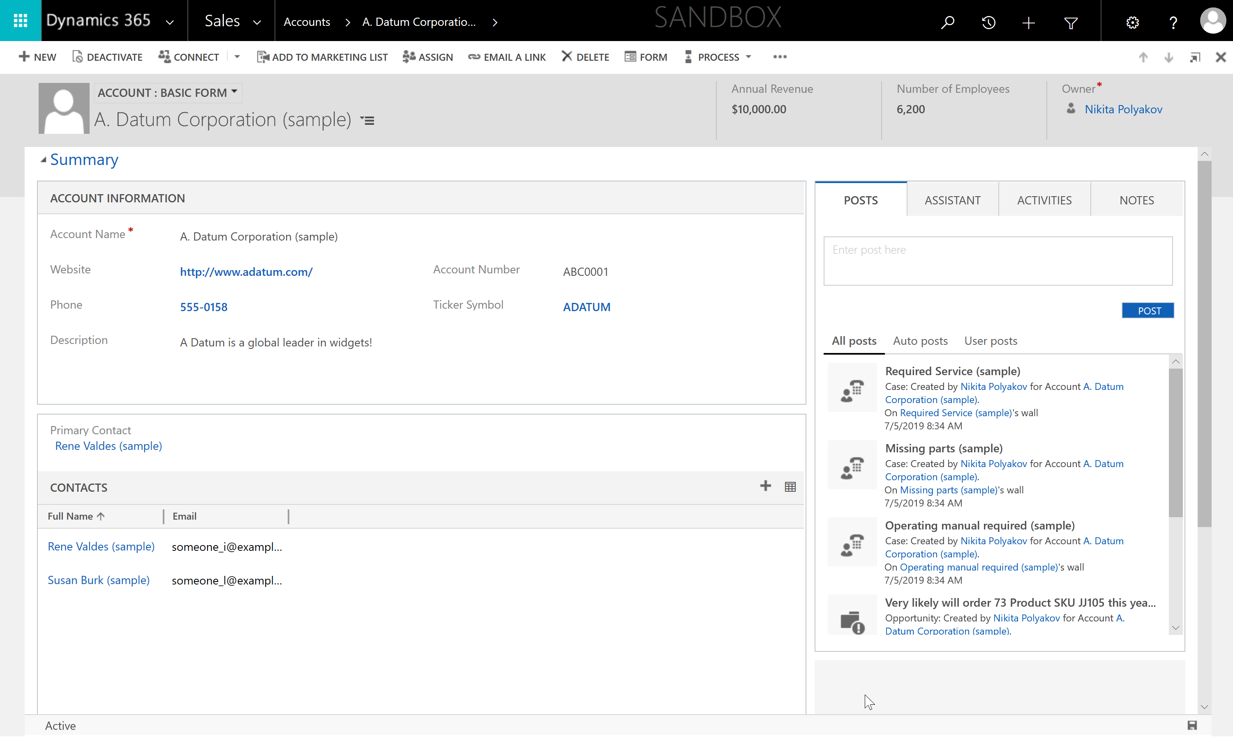
Forms – what happens to my form customizations?
Unified Interface
Legacy web client
1
2
1
2
3
3
Sections are still part of Form layout
Column layout continues as configured
Field formatting and display properties remain as configured

Slide 29
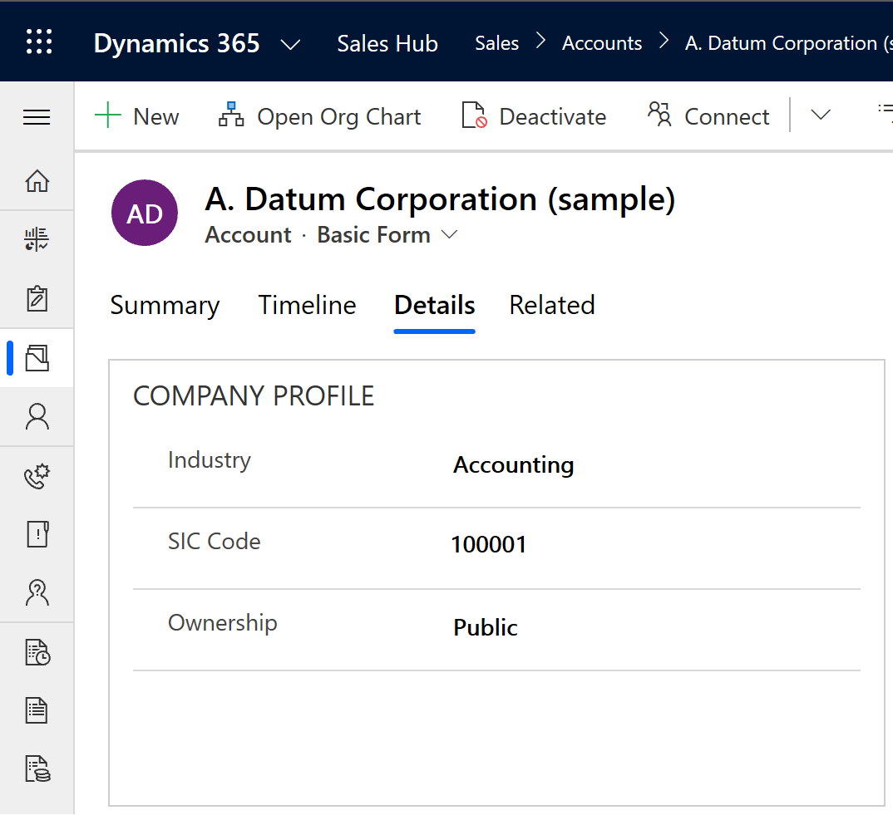
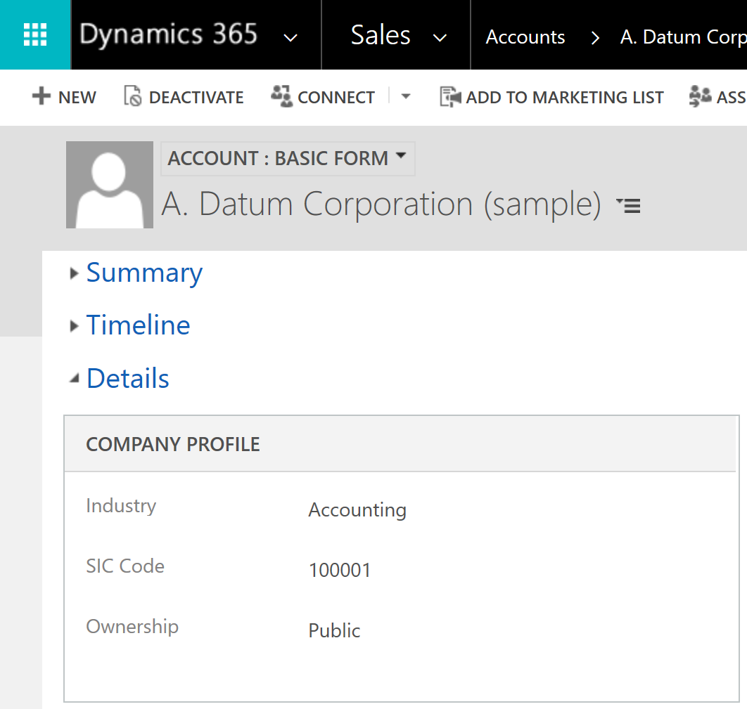
Forms – Tabs navigation is now on top and easily discoverable
Unified Interface
Legacy web client
1
2
Unified Interface
Legacy web client
1. All Tabs are now always presented across the top of the Form easily discoverable by the users
2. Tabs could get lost on the bottom of the Form requiring scrolling or collapsing of other Tabs resulting in stacking reducing form space
VS

Slide 30
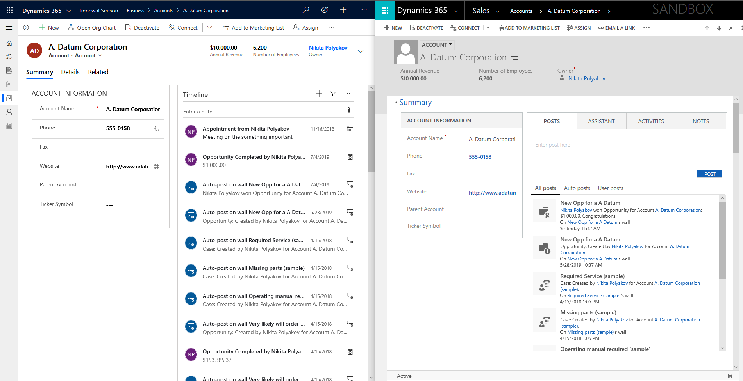
Timeline - improved with more information density and better layout
Unified Interface
Legacy web client
1
Improvements :
All Activity types in one single timeline
Easily identify activity types
See more timeline rows at a time
2
3
9 rows vs 4 rows

Slide 31
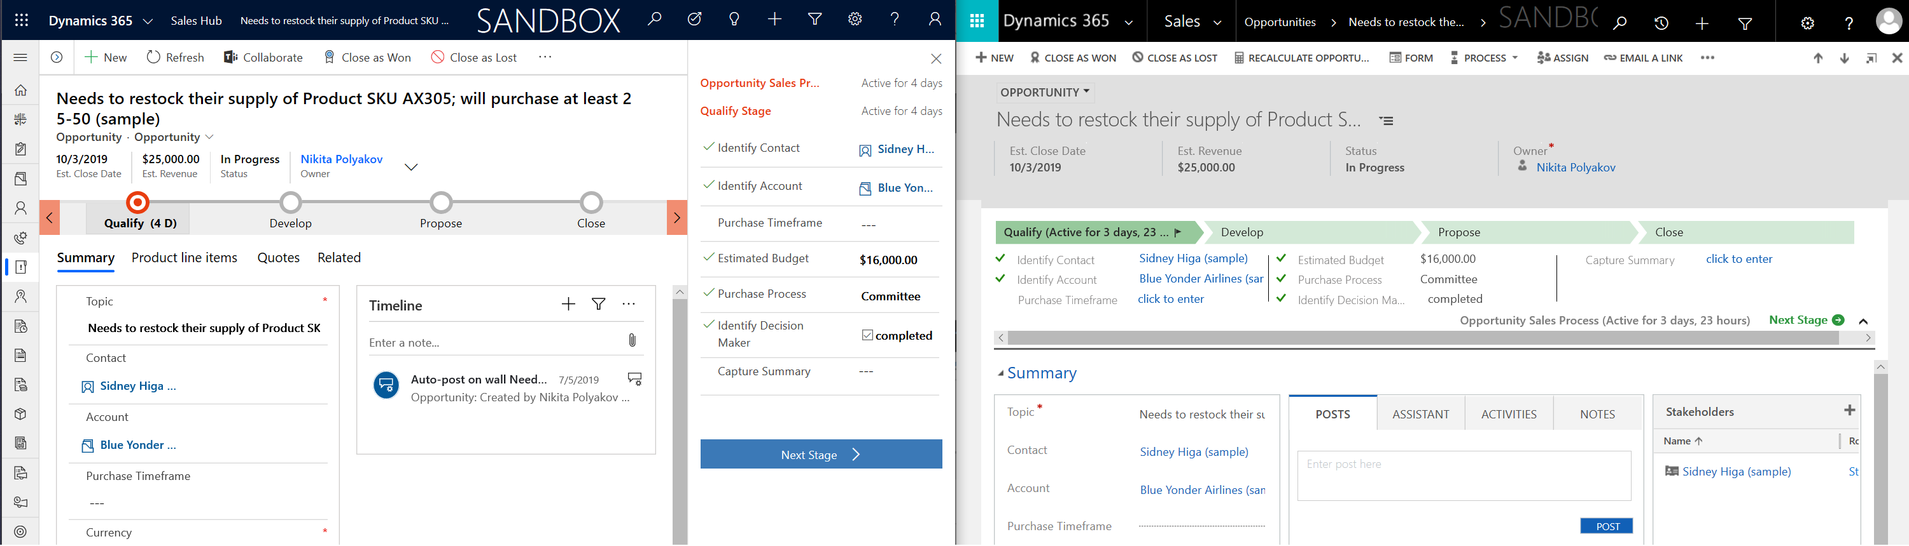
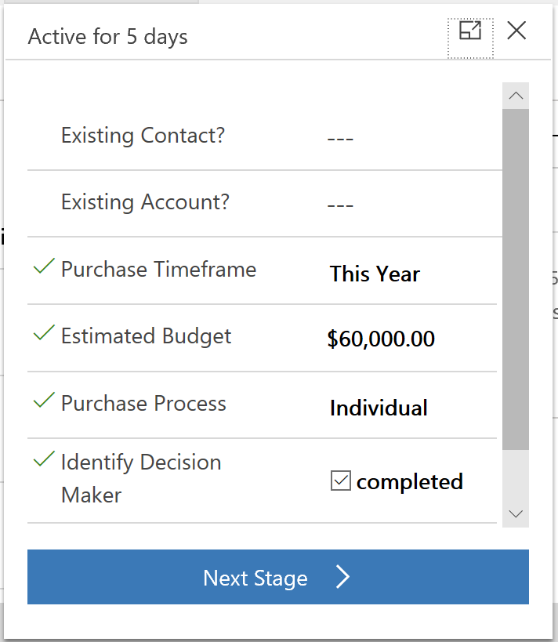
Business Process Flow - Improved
Unified Interface
Legacy web client
1
2
3
New Compact Business Process Flow Bar
On click pop down Stage flyout saves space
Alternatively users can pin Stage flyout details to the side and it will stay pinned when user comes back

Slide 32
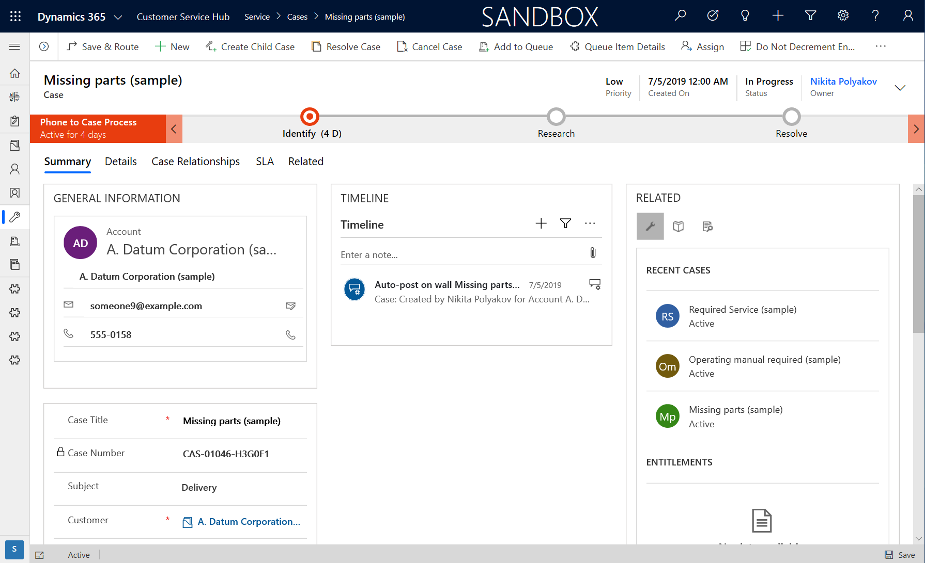
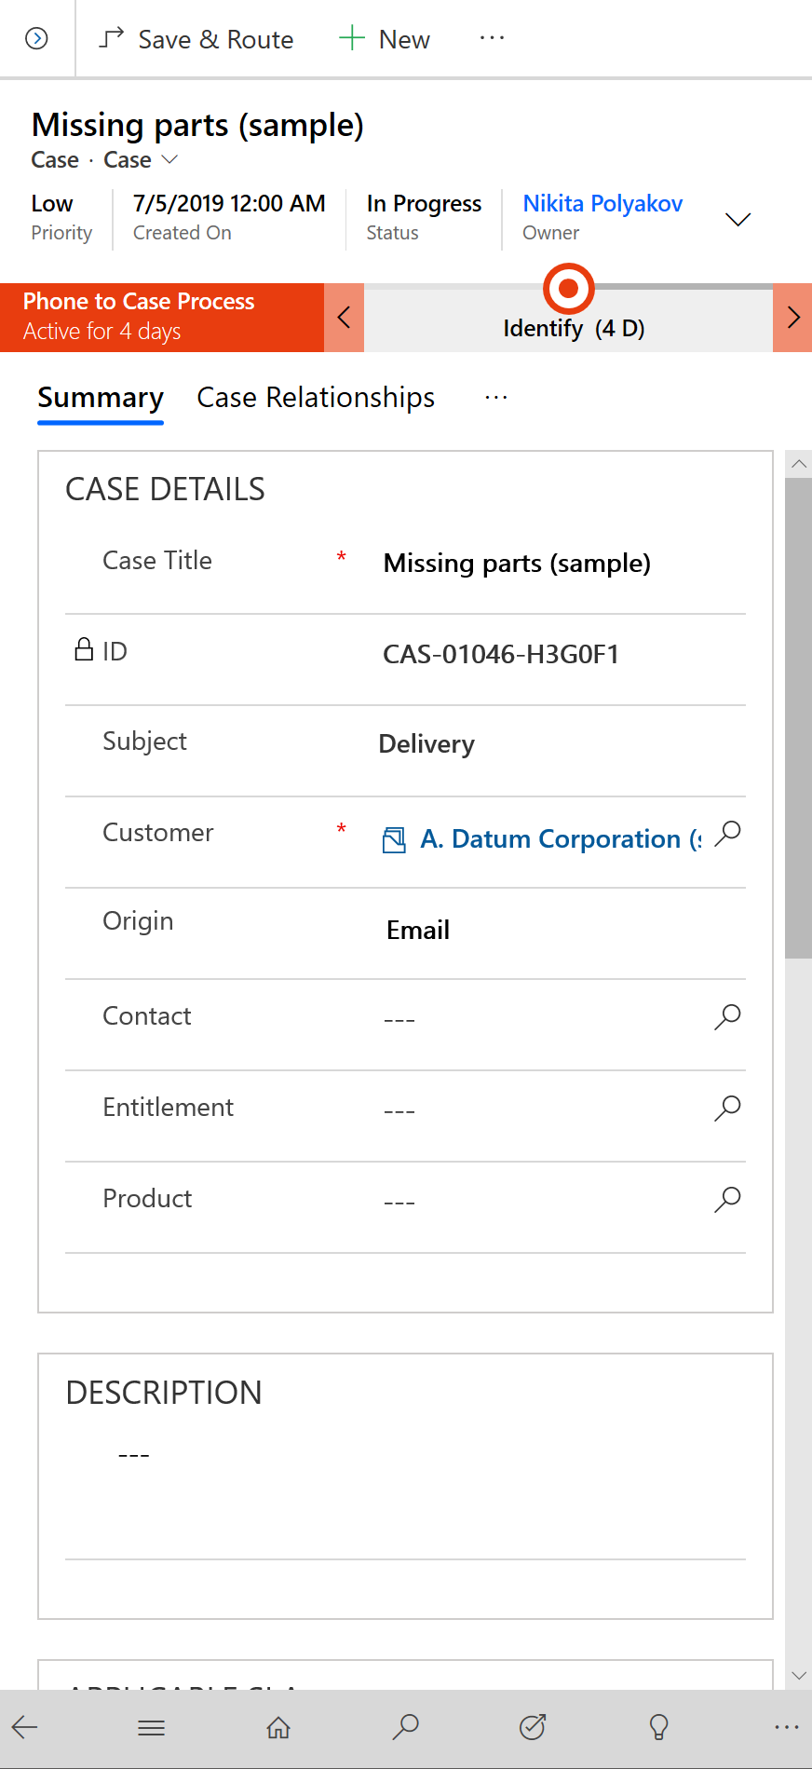
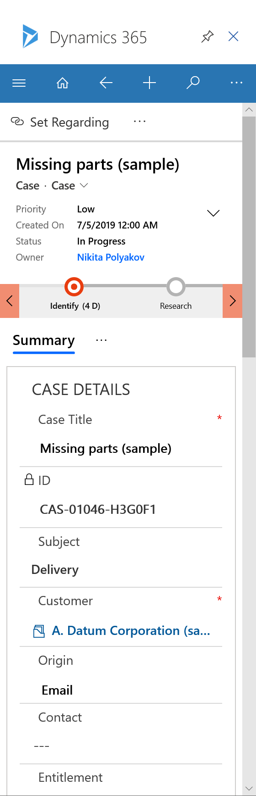
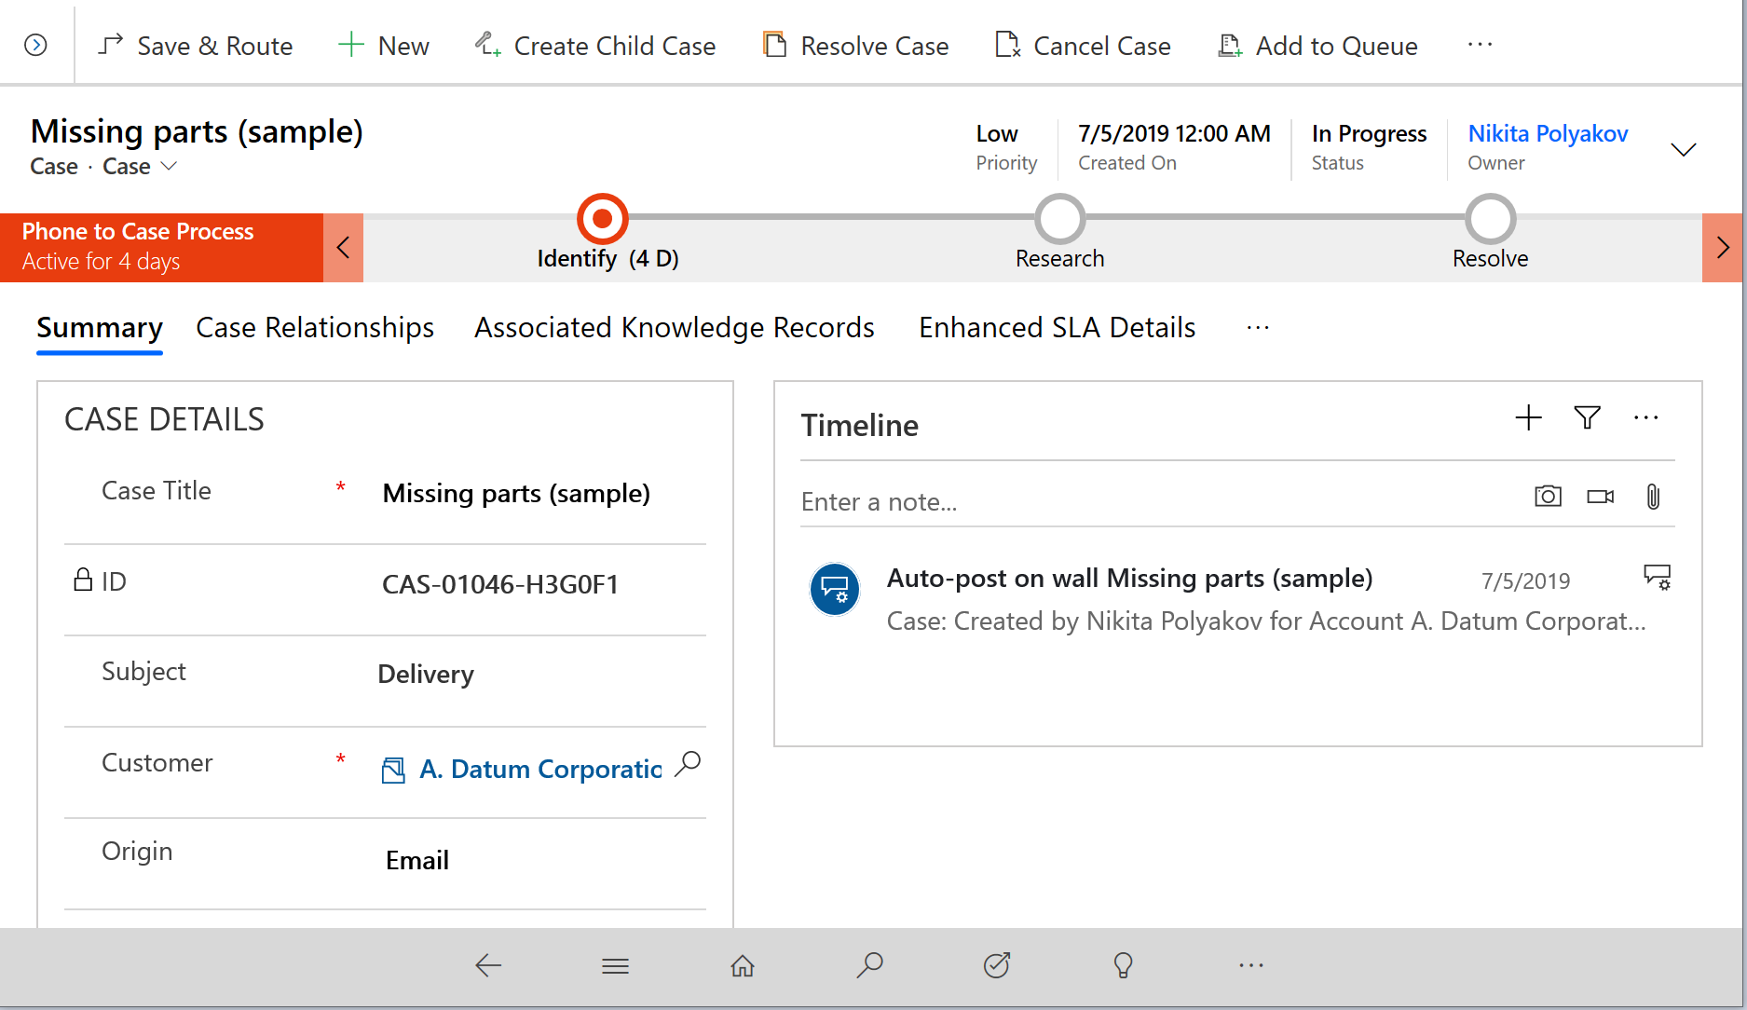
Expand your existing investment from Desktop to Tablet, Phone, Outlook
Tablet
Phone
Outlook

Slide 33
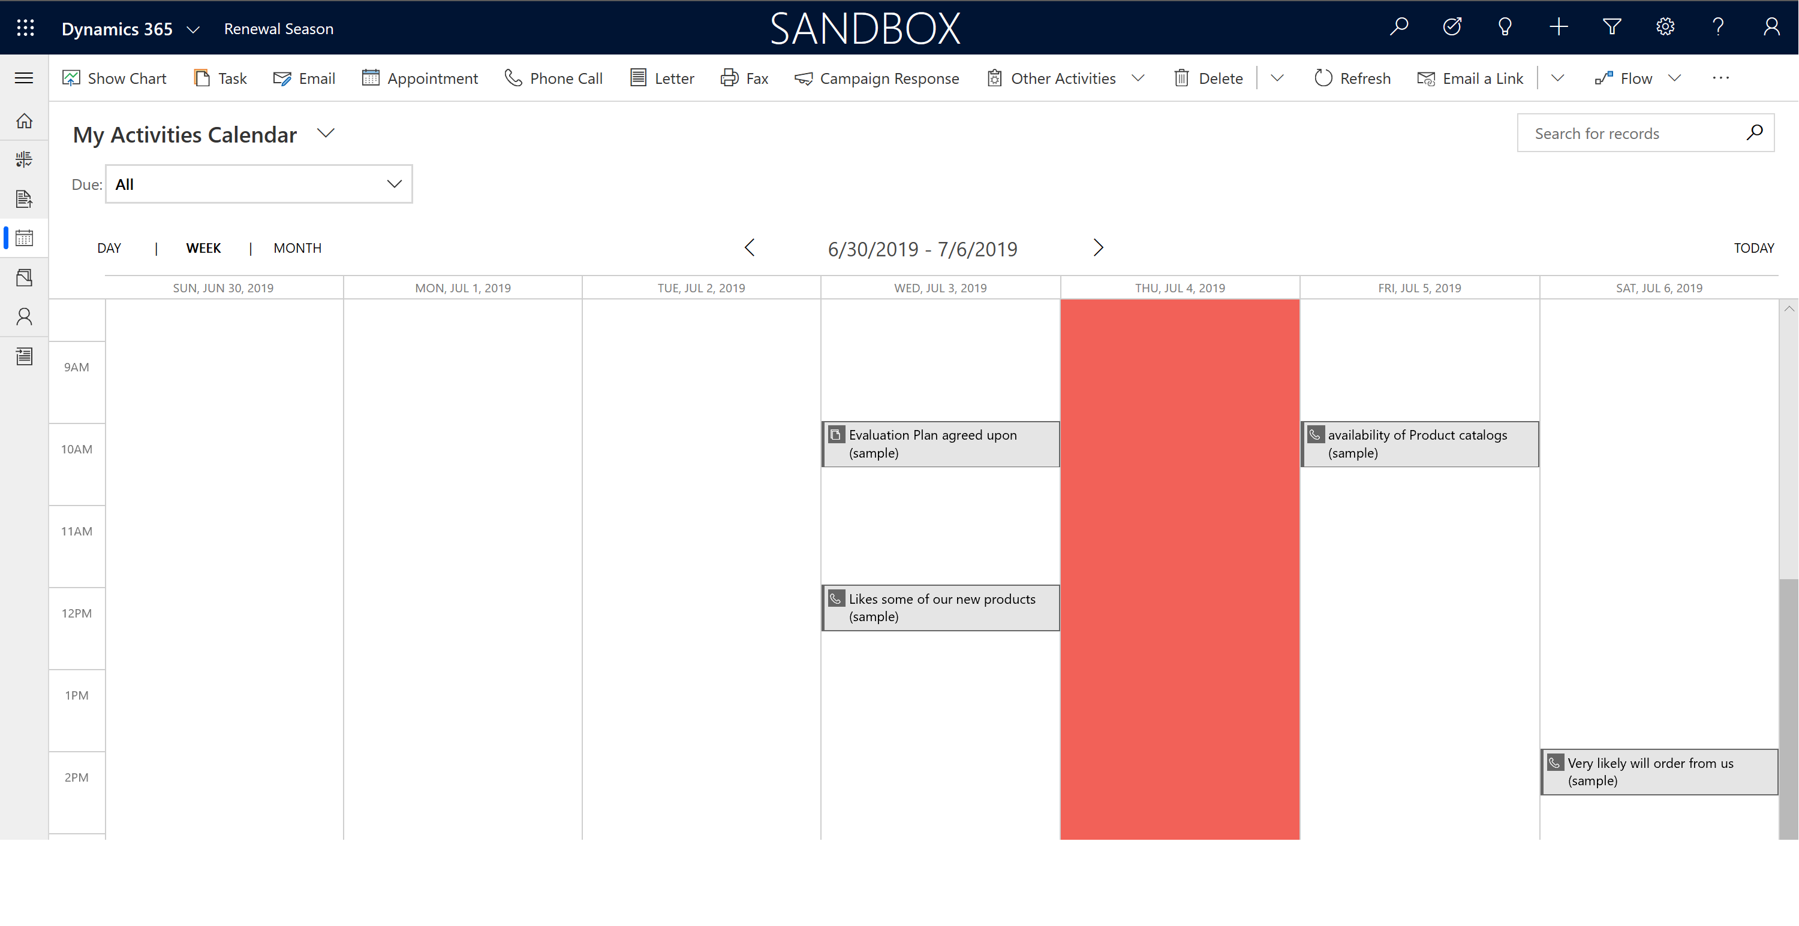
New! Calendar View Control boost context in date-oriented datasets
Use an intuitive Calendar View Control for any entity

Slide 34
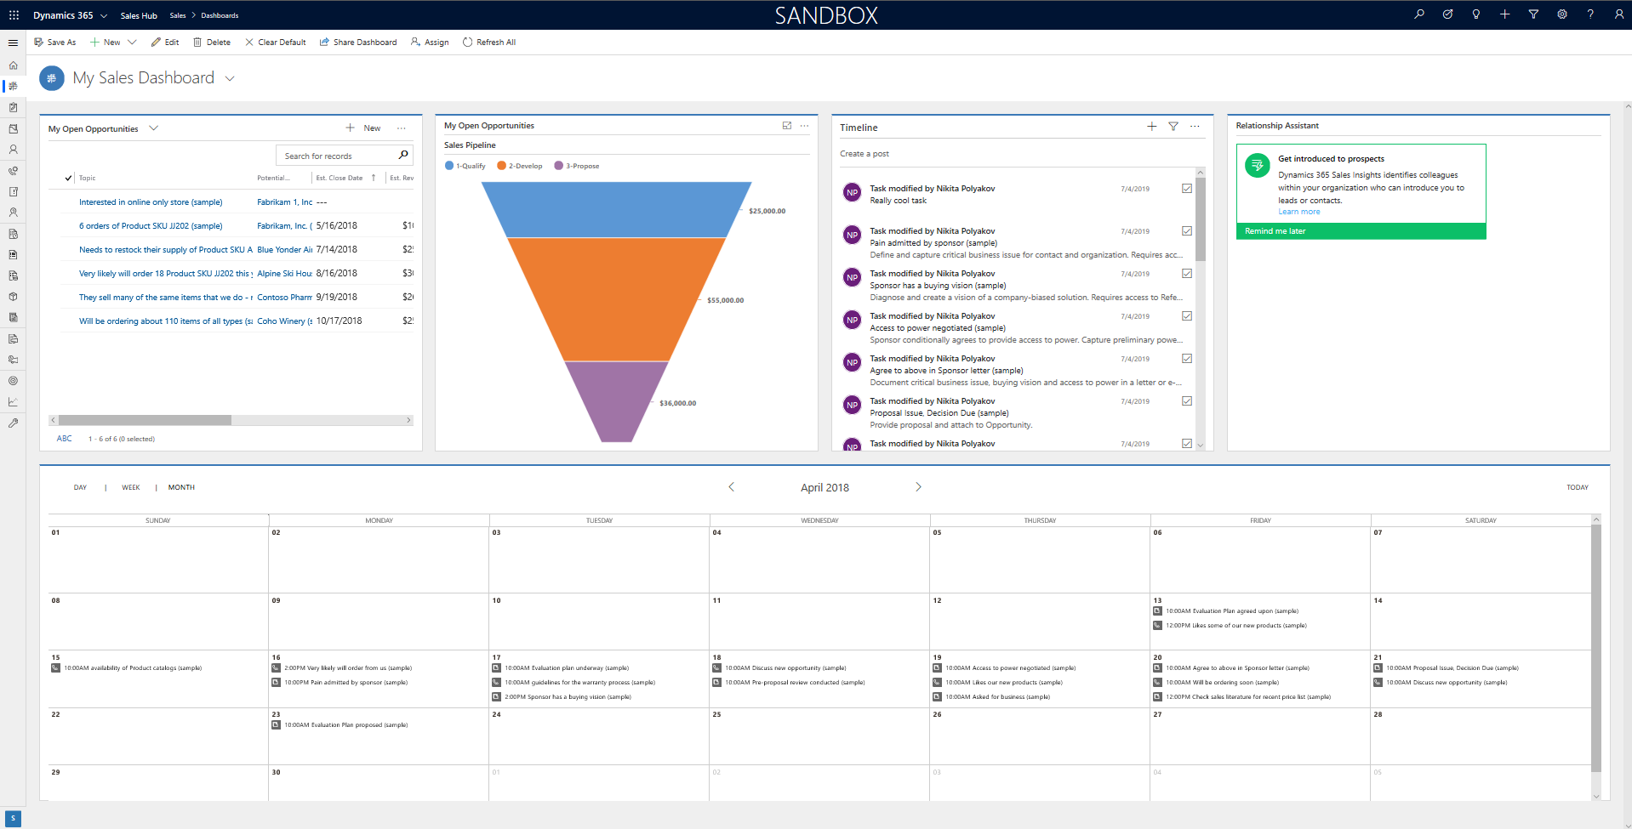
Dashboards – Improved Timeline and New Calendar View Control
Improved Timeline Control
Help users easily take advantage of AI and Insights
Views adjust to available space
New View Control - Calendar

Slide 35
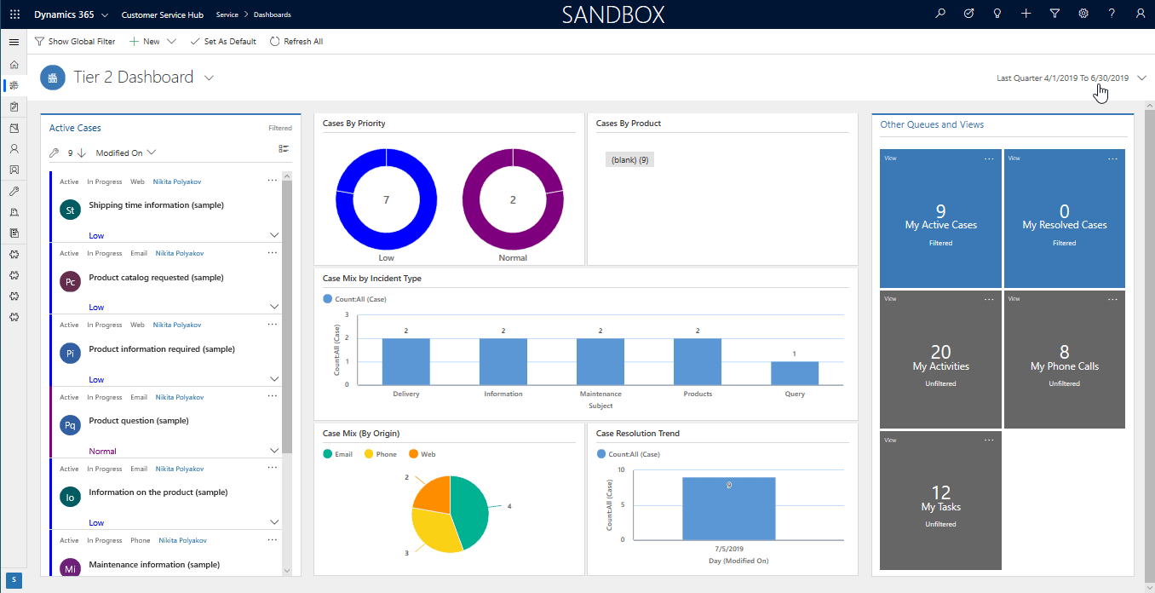
New! Interactive Dashboards – multi-chart & date range filtering
Date Filter
Clicking on any
Charts sections will Filter

Slide 36
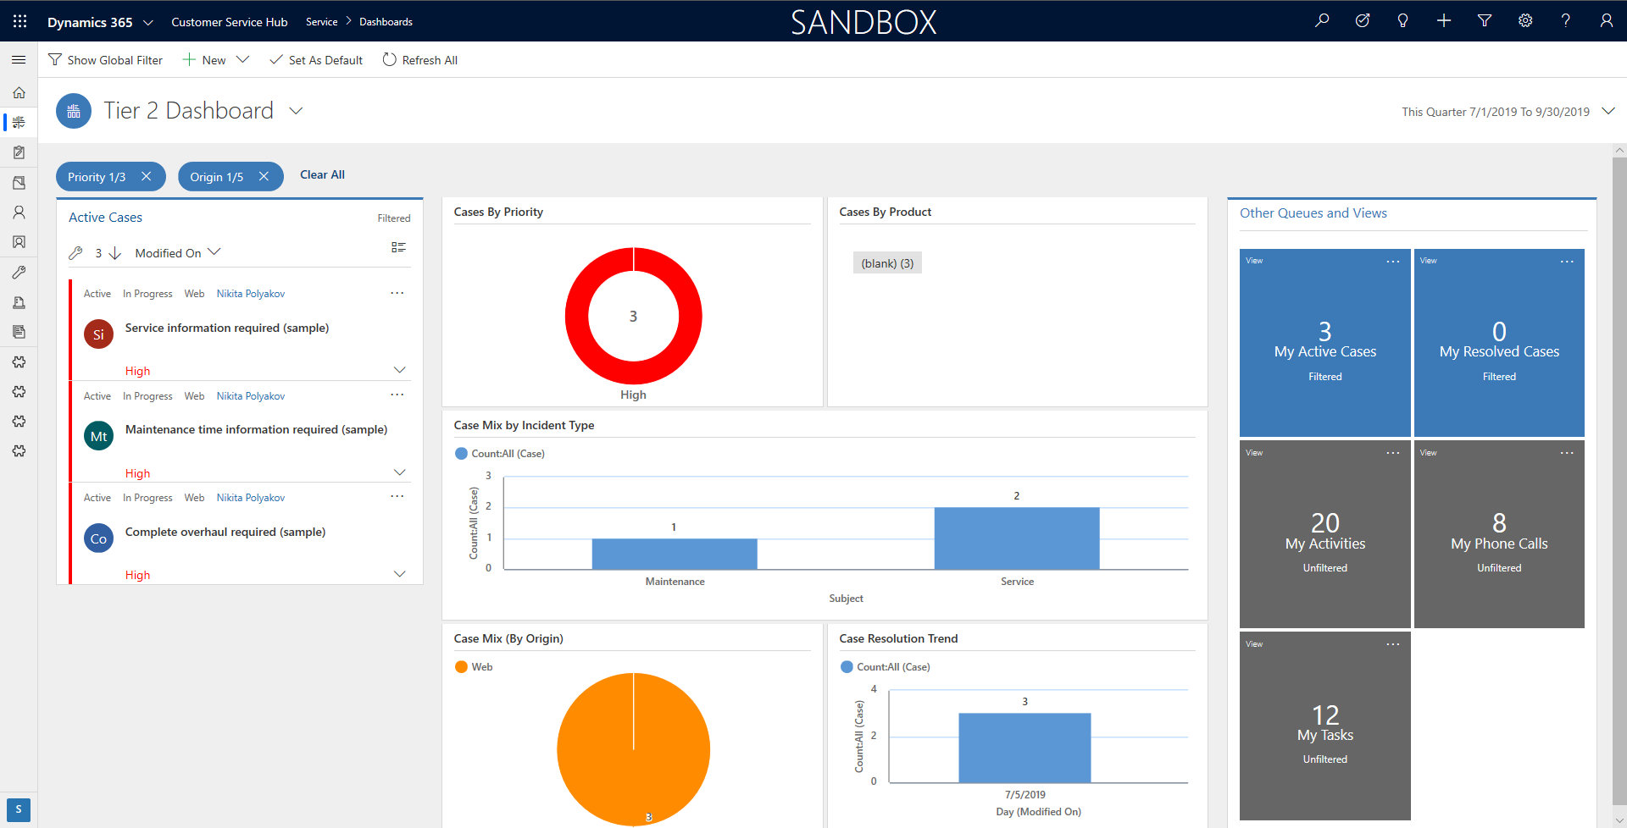
New Interactive Dashboards – multi-chart & date range filtering
Date Filter
Clicking on any
Charts sections will Filter

Slide 37
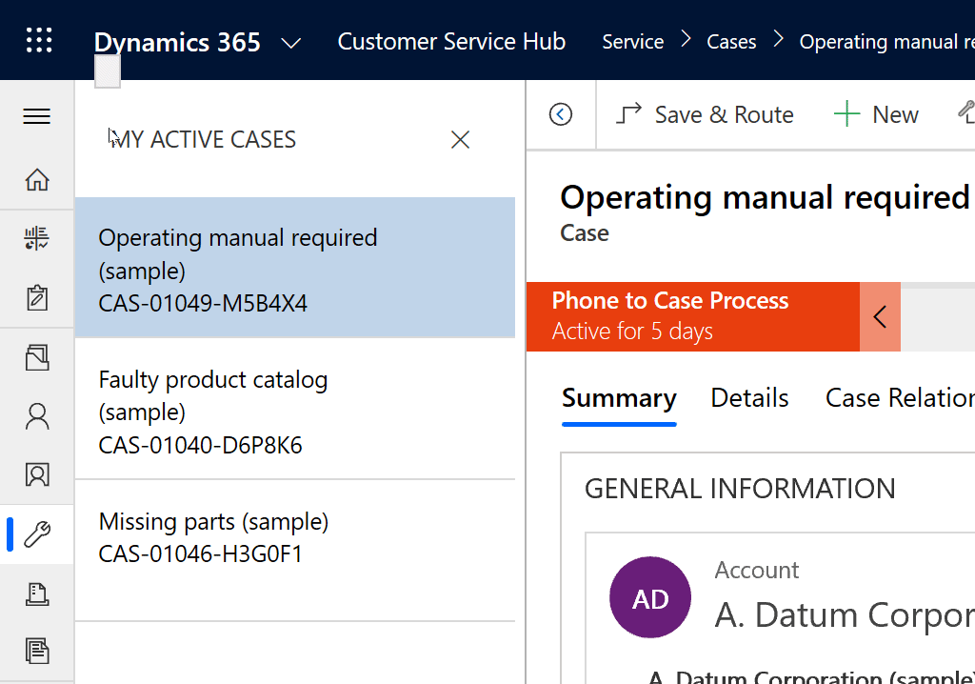
Boost productivity with new Record Set navigation
Boost productivity by quickly navigating between records from:
Any View
Any Filtered View
Any View Search
Any Dashboard
Interactive Dashboard

Slide 38
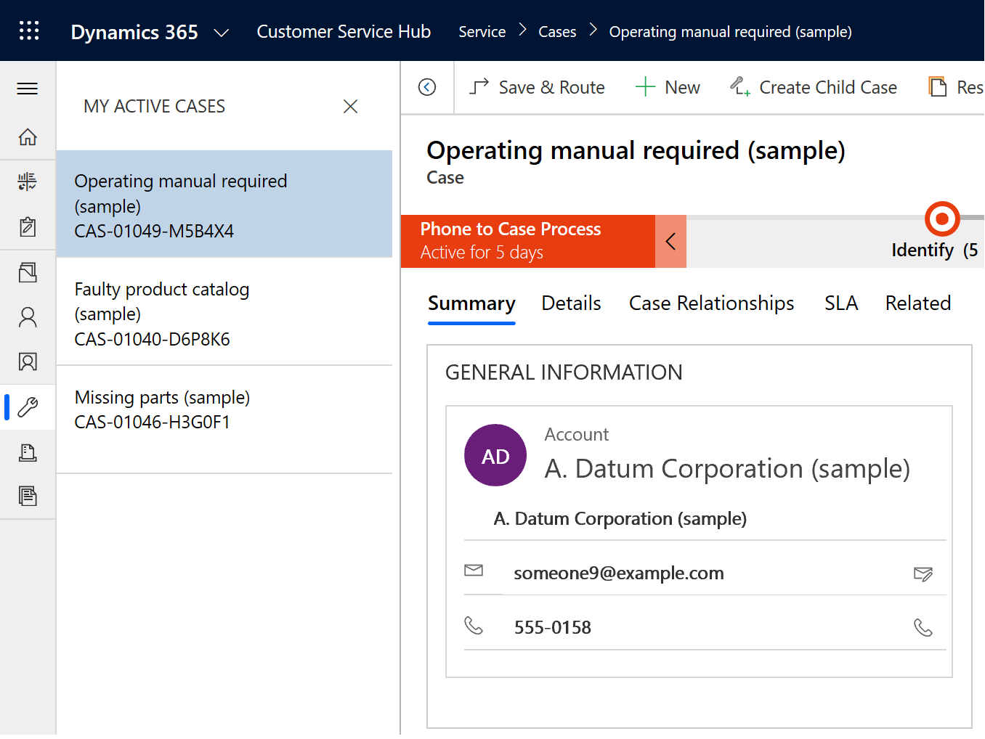
Boost productivity with new Record Set navigation
Boost productivity by quickly navigating between records from:
Any View
Any Filtered View
Any View Search
Any Dashboard
Interactive Dashboard

Slide 39
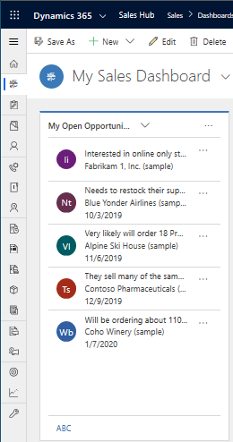
Improved Views use dynamic reflow for best experience in a given space
Narrow space
Wider space
Views and Sub-Grids dynamically adapt to the available space changes from:
Form factor
Screen or Window size
Zoom level
Customizers can pre-configure settings that meet your needs

Slide 40
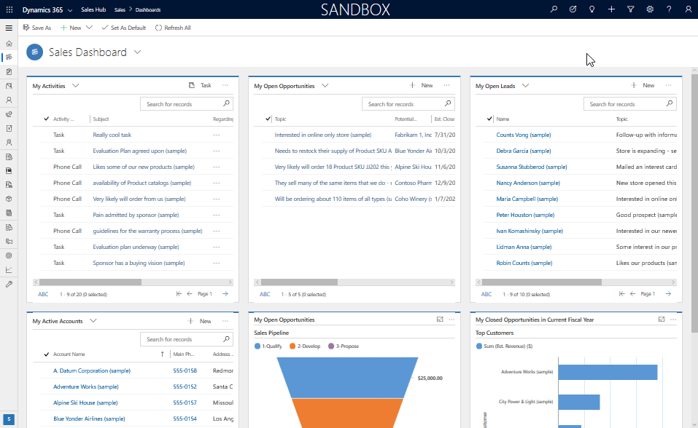
Views and sub-grids reflow to best UI for the space given example

Slide 41
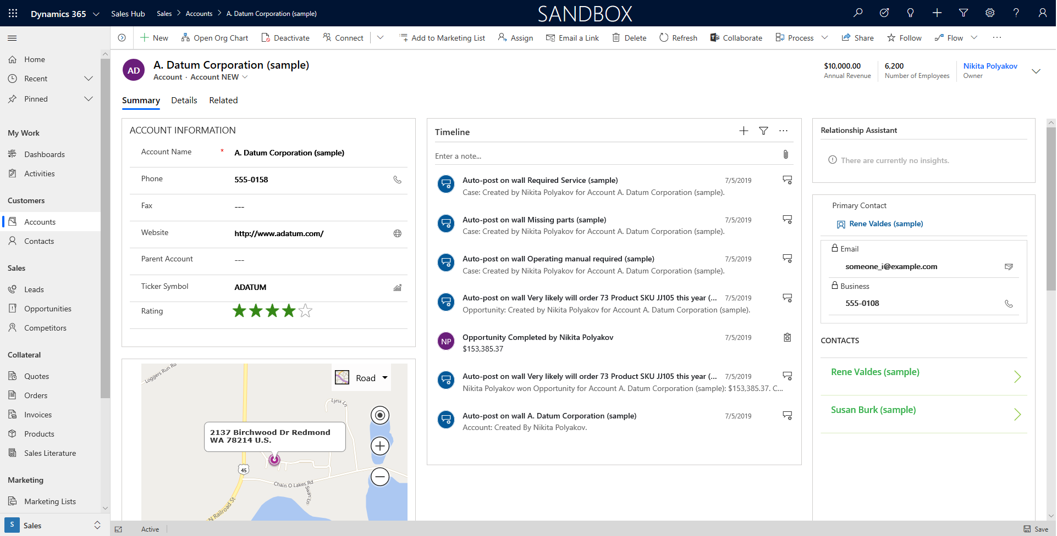
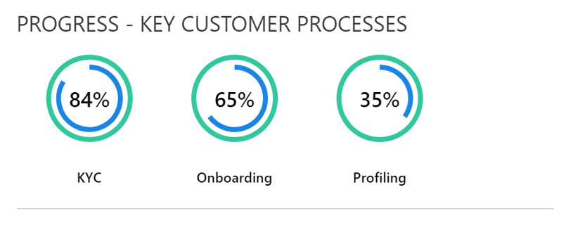

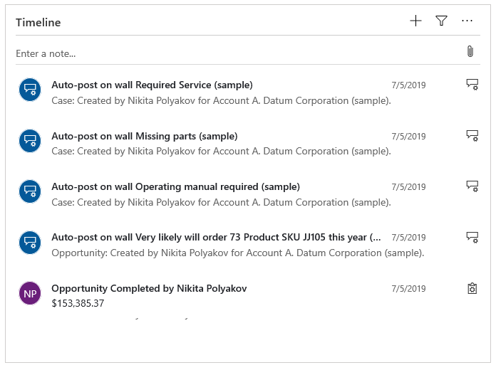
Supercharge your Unified Interface Forms with new capabilities & features!
PowerApps Component Framework
Canvas App Embedding
New Controls for Fields

Slide 42
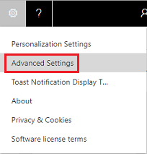
Settings in Unified Interface apps

Slide 43
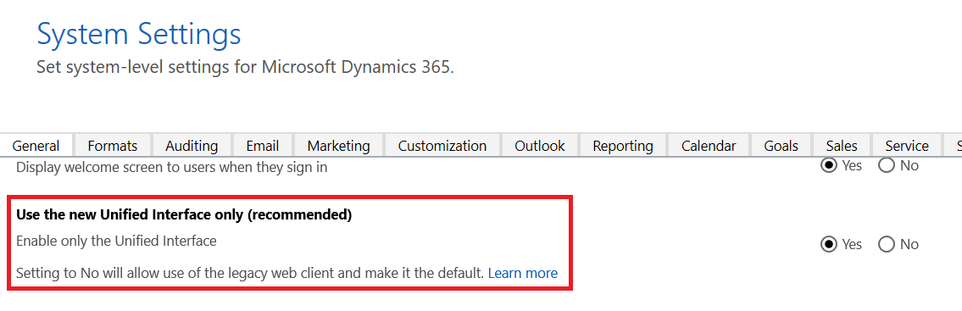
Use the new Unified Interface only (recommended)

Slide 44
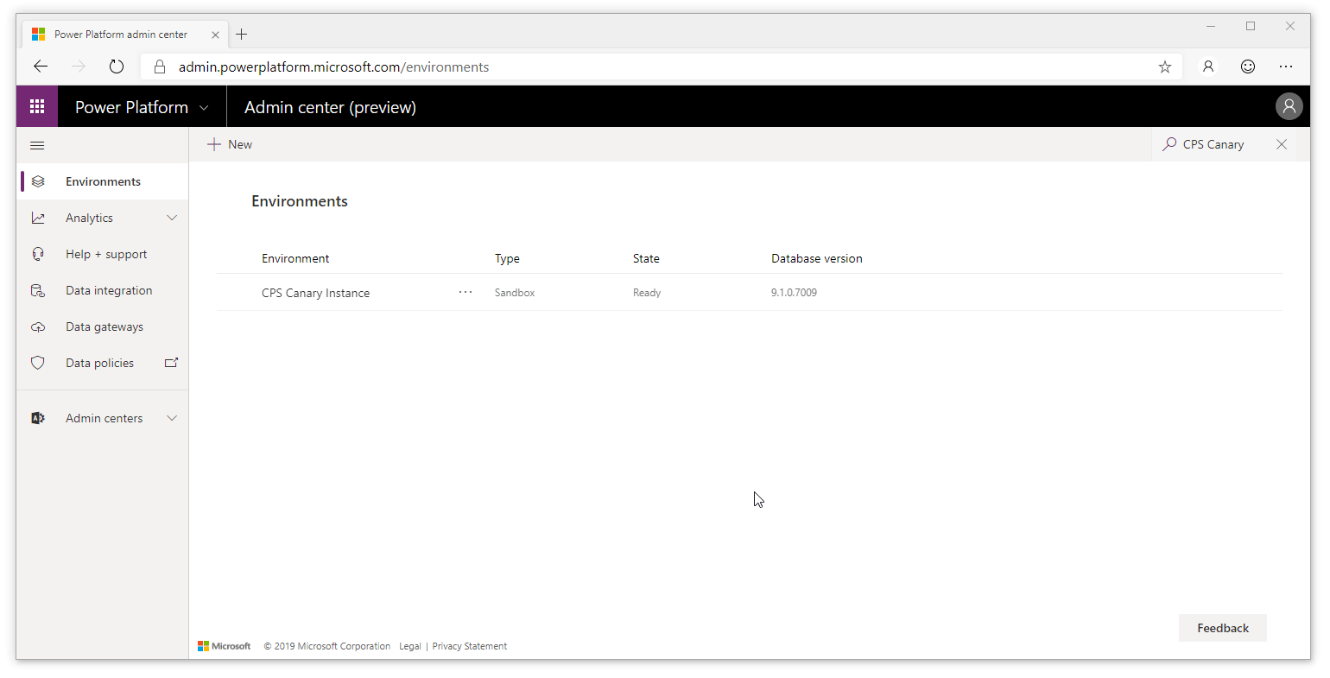
Set up "Unified Interface Only" mode

Slide 45
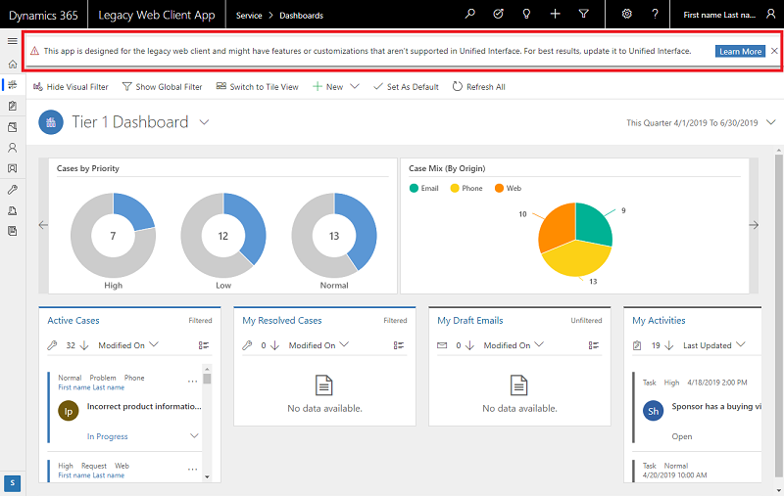
Update your apps to Unified Interface

Slide 46
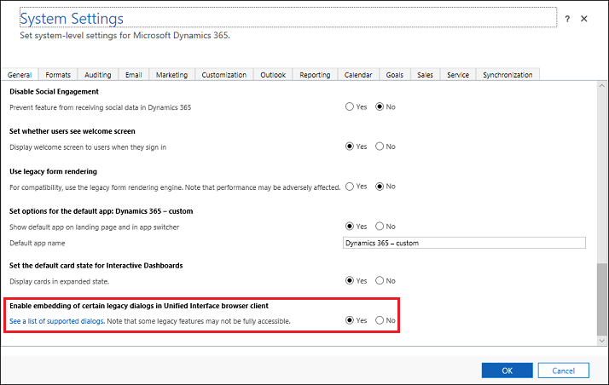
Enable the hybrid experience
Advanced Find
Bulk edit
Merge records
Record sharing
Audit History

Slide 47
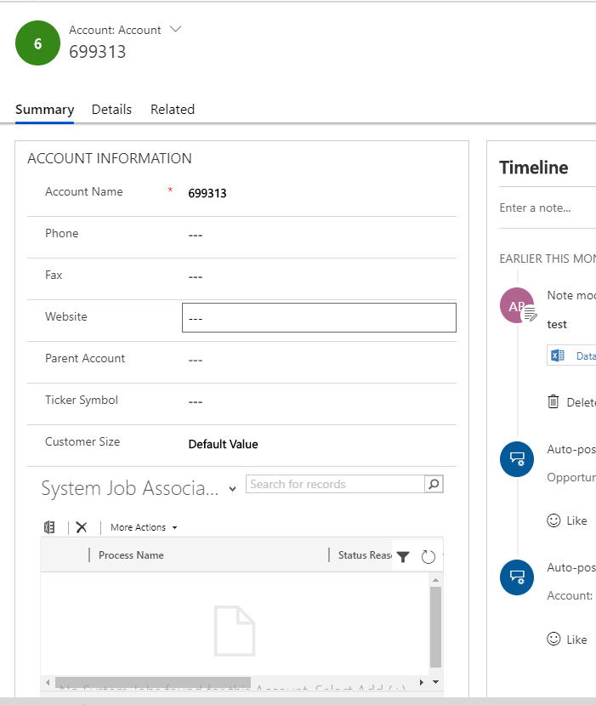
View Process History
No supported
https://crmtipoftheday.com/1312/view-process-history-from-unified-interface-forms/

Slide 48
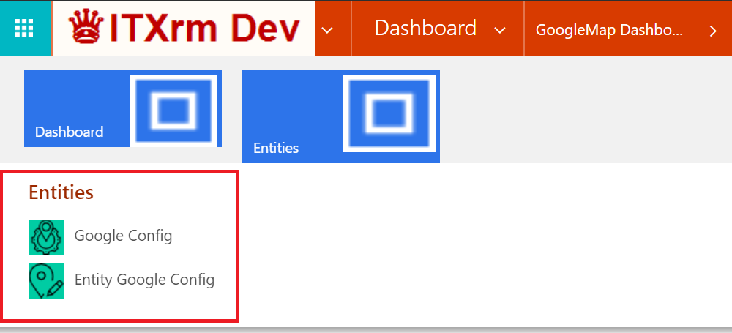
Displaying Icons In A Unified Interface App

Slide 49
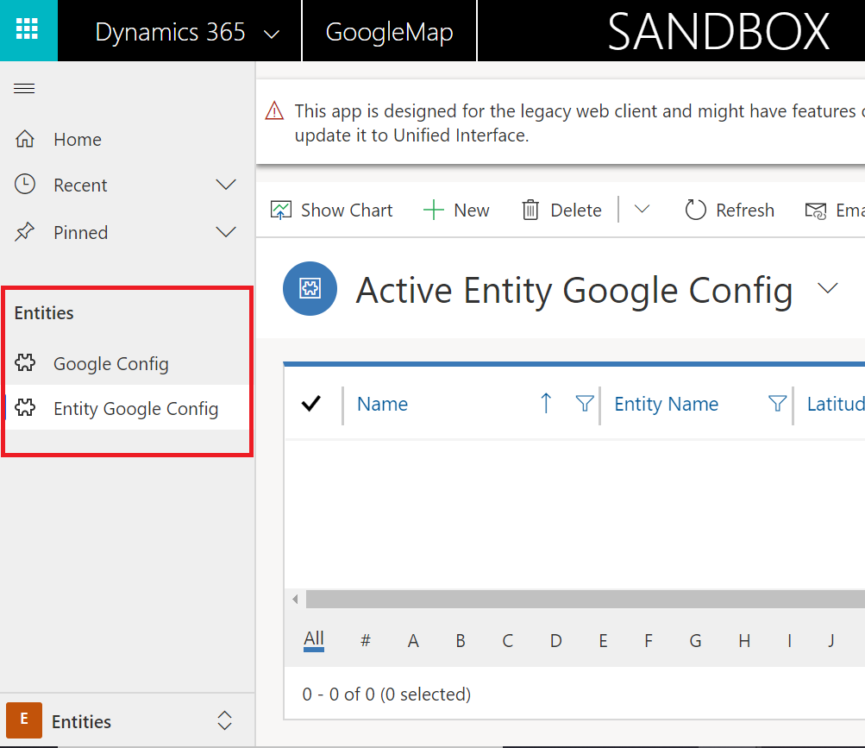
Displaying Icons In A Unified Interface App

Slide 50
Displaying Icons In A Unified Interface App
https://meganvwalker.com/displaying-icons-unified-interface-app/

Slide 51
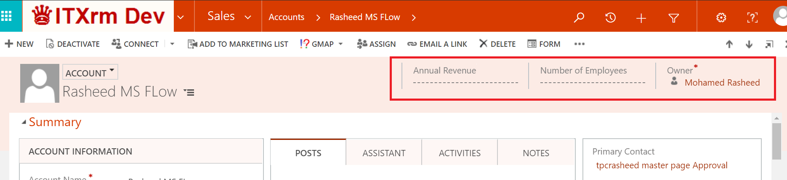
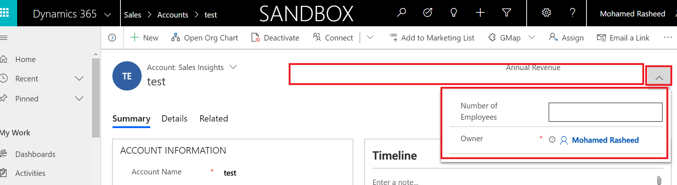
Header

Slide 52
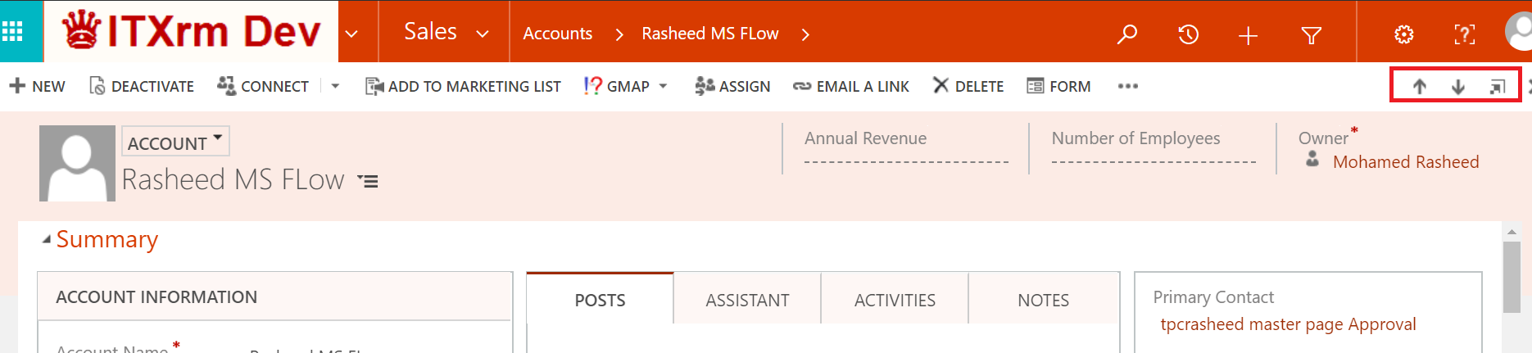
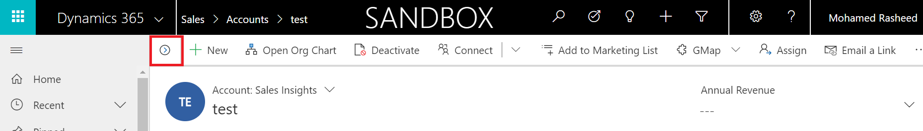
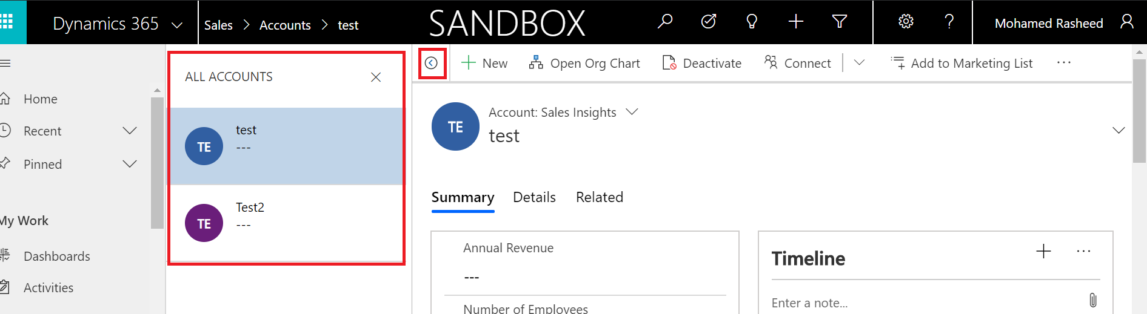
Next Record

Slide 53
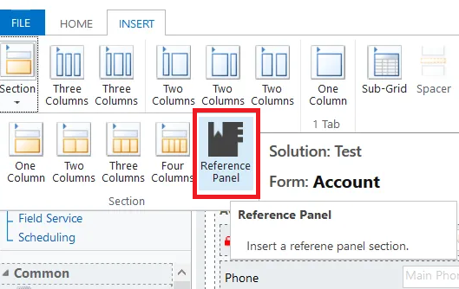
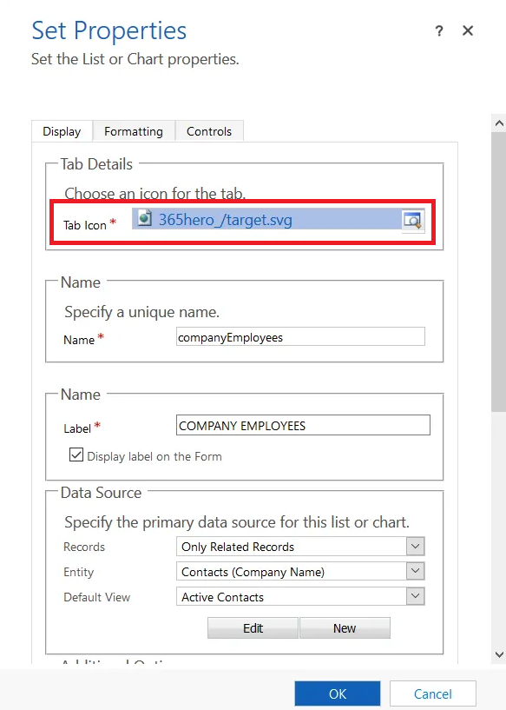
Reference Panel

Slide 54

Reference Panel
https://the365hero.com/blog/2019/01/24/dynamics-365-uci-reference-panels-sub-grid-rendering/

Slide 55




When do I transition?
2019
Start now to deploy by the end of CY 2019
Migrating from
on-premise to online
Advantages of starting migration efforts as soon as possible:
Take advantage of all new investments, features & improvements we deliver. None of these will be on the legacy web client!
It’s faster, more modern and provides more productivity features - to positively increase end-user adoption
Early validation efforts will provide a view on effort required. Address Perception vs Reality – help position effectively with the business
Informing Microsoft early of any blockers will help faster triage and provide solution options sooner, unblocking any issues ahead of time
Important: Microsoft deploys UI changes only in major updates (2x per year)!

Slide 56
Determine the transition path, maybe a hybrid of one of these 3 paths
Targeted App(s) – Incremental approach
Full transition – replace the legacy web client entirely
Benefits
Easier to get started
End-user impact is minimized as transition is done in waves
Areas impacted by issues or gaps can be avoided
Team learns from experience
Drawbacks
Two user interface styles to support and maintain
Users on legacy web client do not get the performance and usability benefits from the Unified Interface
Legacy web client does not get updated with bug fixes and new features
Benefits
Single user interface to support and maintain
All users get the performance and usability benefits from the Unified Interface
User interface is regularly updated with latest bug fixes and new features
Drawbacks
“Big bang” approach is riskier, all issues and gaps need to be considered
All end users are impacted (training, change management
On-Premise to Online migration
Considerations
Moving from v8.2 (or older) to v9.x implies changes to:
Client scripts due to API deprecations
Making unsupported code supported
Changing integrations to work with the cloud
Adding the transition to Unified Interface does add to the workload, but it is offset by doing the training / change management once
56

Slide 57
Important changes
Legacy web client is deprecated ➔ Unified Interface
Task flows are deprecated ➔ Business process flow immersive experiences
Process Dialogs are deprecated ➔ business process flows or canvas apps
Some client APIs are deprecated
Voice of the Customer is deprecated ➔ Microsoft Forms Pro
Dynamics 365 for Blackberry is deprecated
Service scheduling in Dynamics 365 Customer Service is deprecated ➔ Universal Resource Scheduling (URS)
Contracts, Contract Line Items, and Contract Templates entities are deprecated
Standard SLAs in Dynamics 365 Customer Service are deprecated ➔ Enhanced SLAs
Relationship Roles are deprecated ➔ Connection Roles
Mail Merge is deprecated ➔ Word and Excel templates
Announcements are deprecated
Silverlight (XAP) web resource is deprecated ➔ HTML web resources
Removal of the Microsoft Dynamics CRM List Component ➔ Server-based SharePoint integration
Removal of support for Microsoft Office 2010
Microsoft Dynamics Email Router is deprecated ➔ Server-side synchronization
Microsoft Dynamics CRM 2011 endpoint ➔ Web API
Reference: https://docs.microsoft.com/en-us/power-platform/important-changes-coming

Slide 58
Some client APIs are deprecated
Xrm.Page ➔ ExecutionContext.getFormContext
Xrm.Page.context ➔ Xrm.Utility.getGlobalContext
Xrm.Mobile.offline ➔ Xrm.WebApi.offline
parent.Xrm, addOnKeyPress, showAutoComplete ➔ Depreciated
…
Reference: https://docs.microsoft.com/en-us/power-platform/important-changes-coming#some-client-apis-are-deprecated

Slide 59
What if not upgrade
In the coming months, for those that have not already made the transition, we will be sending reminders and scheduling updates to transition customers to Unified Interface prior to October 1, 2020. The Dynamics 365 legacy web client, process dialogs, and task flows will no longer be available starting on October 1, 2020.
Reference: https://community.dynamics.com/365/b/365teamblog/posts/announcing-the-timeline-to-move-to-unified-interface-2137660788

Slide 60
https://www.facebook.com/RasheedITLec/
https://twitter.com/Rasheed_ITLec
https://www.youtube.com/channel/UCI_UMrnQMXbE216WrsmqGpw
Thanks …

